Slide 1
Description of variable describing customers activities
Total Duration of the xDR in ms
Minimum value | 7.142988e+06
Maximum value | 1.859336e+09
average | 1.051299e+08
1st quartile | 5.837439e+07
2nd quartile | 8.639999e+07
3rd quartile | 1.329664e+08

Slide 2
Session Duration in ms
Minimum value | 7.142000e+03
Maximum value | 1.859336e+06
average | 1.051294e+05
1st quartile | 5.837400e+04
2nd quartile | 8.639900e+04
3rd quartile | 1.329658e+05

Slide 3
Total Download Data
Minimum value | 7.114041e+06
Maximum value | 9.029696e+08
average | 4.546996e+08
1st quartile | 2.431725e+08
2nd quartile | 4.560177e+08
3rd quartile | 6.657654e+08

Slide 4
Total Upload data
Minimum value | 2.866892e+06
Maximum value | 7.833131e+07
average | 4.112015e+07
1st quartile | 3.321763e+07
2nd quartile | 4.114375e+07
3rd quartile | 4.903338e+07

Slide 5
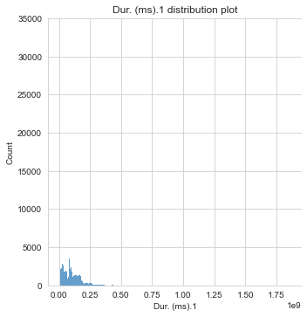
Distribution plots for variable in relation to whole dataset
Total duration of the xDR in ms
The duration distribution lies mostly between 0 and 1/8 of a millisecond with count less than 3000.

Slide 6
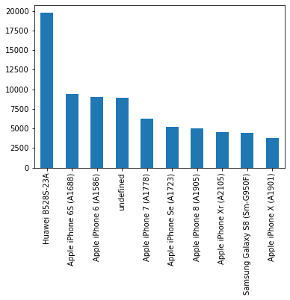
Mostly used Handset Type

Slide 7
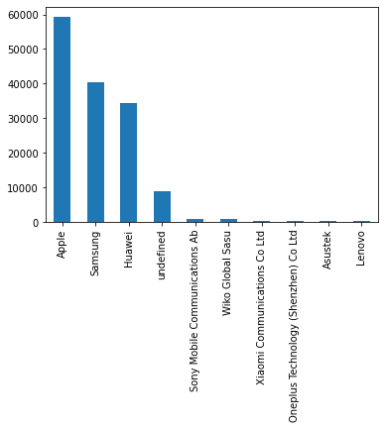
Mostly used Handset Manufacturer

Slide 8
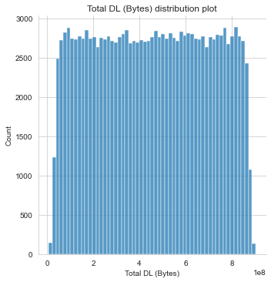
Total Download Volume distribution plot
The distribution rises quickly from 0 to 2500s, stays almost constant until it falls quickly at the end.

Slide 9
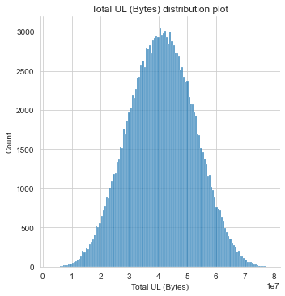
Total Upload Volume distribution plot
The distribution rises slowly until it reaches 3000 count with its upload bytes at the median and then descends slowly.

Slide 10
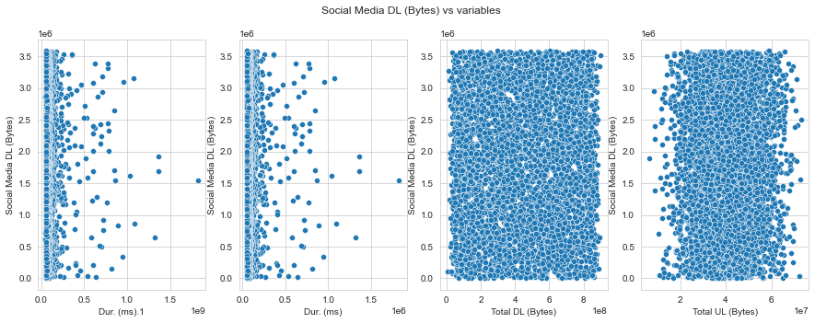
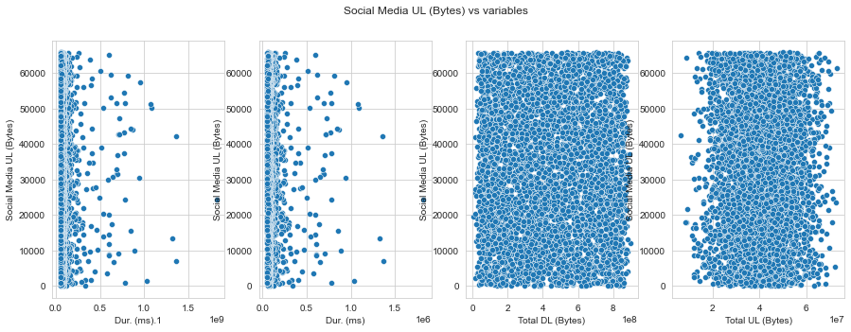
Graphical Univariate analysis for different applications vs the variables for a sample of 1000
Social Media Downloads
The duration for both is mostly concentrated between 0-0.5 ms
The total download is equally distributed
The total upload is somewhat distributed with more concentration in the middle

Slide 11
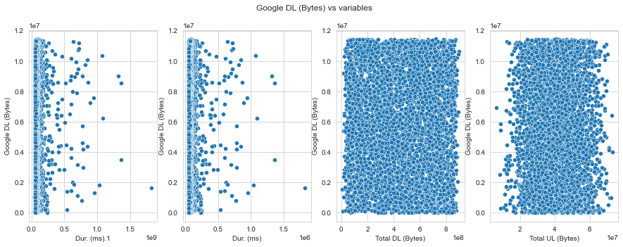
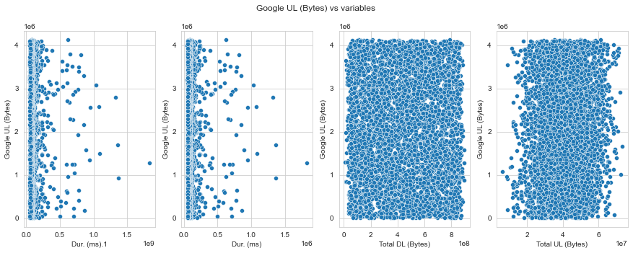
Google plots
The duration for both is mostly concentrated between 0-0.5 ms
The total download is equally distributed
The total upload is somewhat distributed with more concentration in the middle

Slide 12
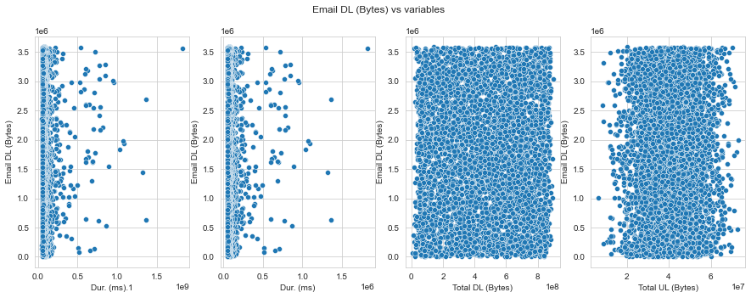
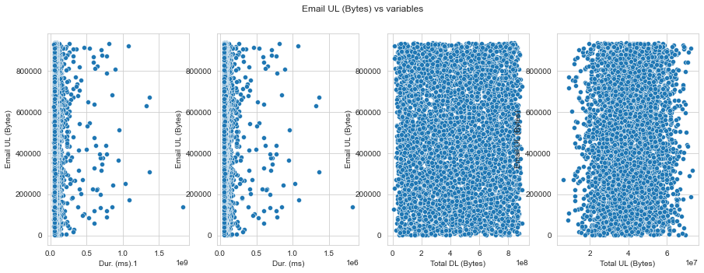
Email plots
The duration for both is mostly concentrated between 0-0.5 ms
The total download is equally distributed
The total upload is somewhat distributed with more concentration in the middle

Slide 13
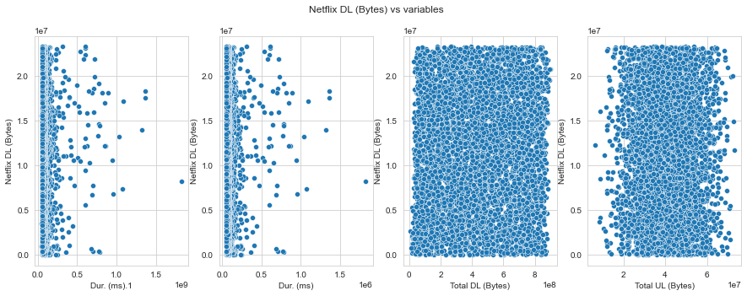
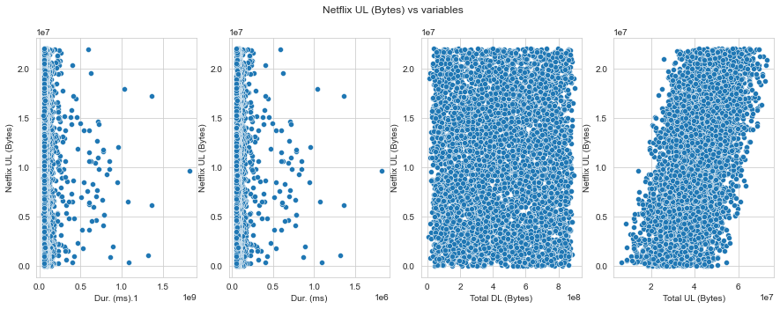
Netflix plots
The duration for both is mostly concentrated between 0-0.5 ms
The total download is equally distributed
The total upload is somewhat distributed with more concentration in the middle

Slide 14
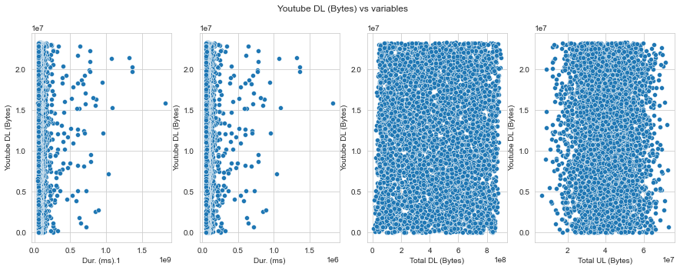
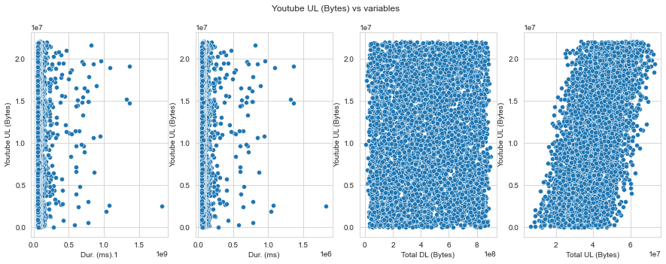
Youtube plots
The duration for both is mostly concentrated between 0-0.5 ms
The total download is equally distributed
The total upload is somewhat distributed with more concentration in the middle

Slide 15
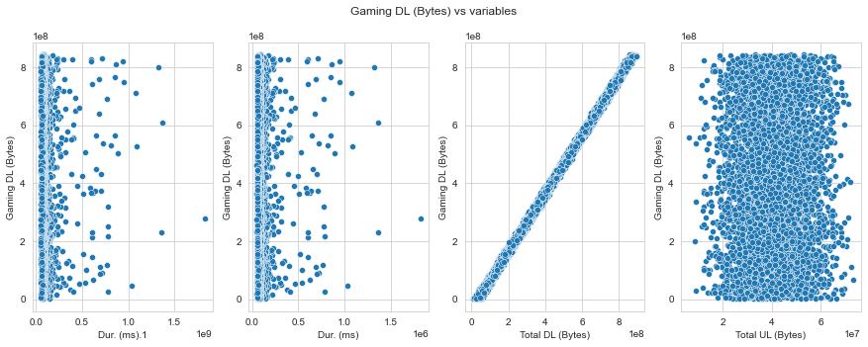
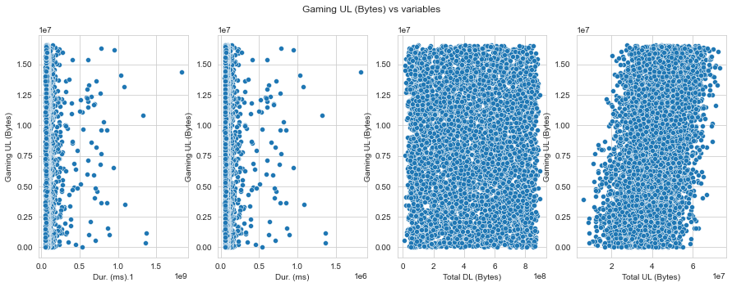
Gaming Plots
The duration for both is mostly concentrated between 0-0.5 ms
The total download is equally distributed on gaming upload but rises in a straight oblique line for gaming download in relation to total download
The total upload is somewhat distributed with more concentration in the middle on total download, and total upload follows an oblique rising pattern in relation to gaming upload

Slide 16
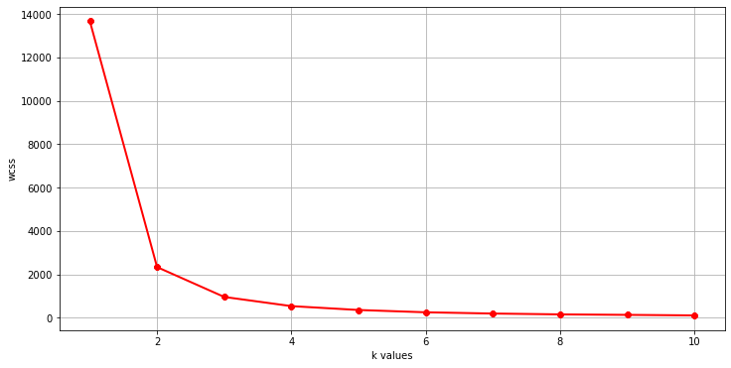
Optimal cluster values using elbow data
Using elbow method, the best classifications counts to be found from our data are 3 as seen from the graph.

Slide 17
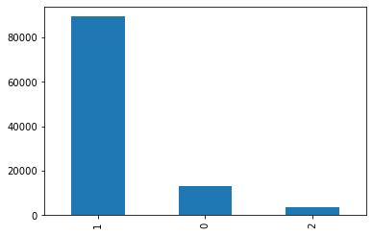
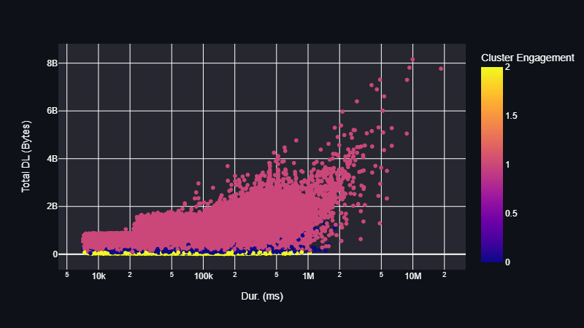
Engagement Clusters
From the graph, we observe the most engaged customers belong to cluster 1

Slide 18
Engagement Clusters
From the graph, we observe the most engaged customers belong to cluster 1
Descriptions about mean for each cluster:
Variables | Mean cluster 1 | Mean cluster 0 | Mean cluster 2
Duration | 2.420023e+06 | 2.929371e+05 | 1.892775e+05
Total DL | 1.413801e+09 | 2.571667e+08 | 5.810468e+07
Total UL | 1.227956e+08 | 6.307089e+07 | 4.466235e+07
Decile | 1.116656e+04 | 1.659390e+03 | 4.729893e+02
Satisfaction score | 2.163723e+09 | 4.536743e+08 | 1.456310e+08

Slide 19
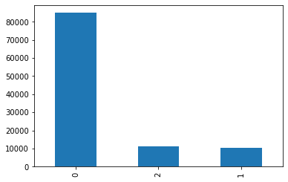
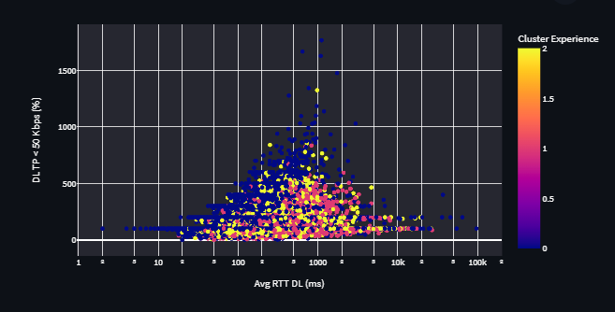
Experience Clusters
From the observations from the experience clusters, cluster 0 has the highest count

Slide 20
Experience Clusters
From the graph, we observe the most engaged customers belong to cluster 0
Descriptions about mean for each cluster:
Variables | Mean cluster 0 | Mean cluster 2 | Mean cluster 1
Duration | 2.421906e+06 | 7.789314e+05 | 6.654174e+05
Total DL | 1.208157e+08 | 1.084307e+08 | 1.054051e+09
Total UL | 1.360509e+09 | 1.305942e+09 | 9.470554e+07
Decile | 1.061507e+04 | 1.382236e+03 | 1.300965e+03
Satisfaction score | 2.088941e+09 | 2.003189e+09 | 1.625822e+09

Slide 21
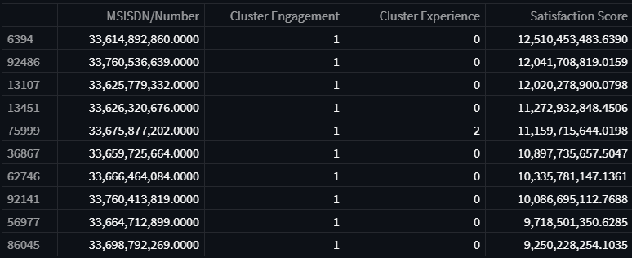
Top 10 most satisfied customers

Slide 22
Creator
Names: Floris Nzabakira
Email: nzafloris@gmail.com
GitHub: https://github.com/Kira-Floris/TellCo

